Slide 1
Chapter 6 Limited Direct Execution
Chien-Chung Shen
CIS/UD
cshen@udel.edu

Slide 2
Virtualization Mechanism
Virtualize (physical) CPU via “time” sharing
Two challenges
performance – with minimum overhead
control – retain control of CPU
Challenge: how to efficiently virtualize CPU with control
➔attaining performance while maintaining control
Need hardware support
mode bit
Technique: Limited Direct Execution
Notes:
----- Meeting Notes (2/10/16 17:01) -----
39339
<number>

Slide 3
Direction Execution without Limits
OS Program
create an entry in process list
allocate memory for process
load program into memory
set up stack with argc/argv
clear registers
execute “call main()”
run main()
execute return from main()
free memory of process
remove from process list
Question: what happens when the program runs forever?

Slide 4
Limited Direct Execution
“Direct Execution” – run programs directly on CPU
Two issues
#1 if we just run a program, how can OS make sure the program doesn’t do anything that we don’t want it to do, while still running it efficiently?
#2 when we are running a process, how does OS stop it from running and switch to another process (i.e., how does OS implement time sharing)?
Without limits on running programs, the OS would not be in control of anything

Slide 5
How to Perform Restricted Operations?
A user process must be able to perform I/O and some other restricted operations, but without giving the process complete control over the system
How can OS and hardware work together to do so?

Slide 6
#1 Restricted Operations
Advantage of direct execution:
fast - program runs natively on hardware CPU and thus executes as quickly as one would expect
What if the process wishes to perform “restricted” operations (e.g., I/O request or accessing more resources)?
How to perform restricted operation on behalf of user process?
OS and H/W work together ➔protected control transfer

Slide 7
Protected Control Transfer
Hardware assists OS by providing different modes of execution
mode bit to dedicate processor mode
user mode - applications do not have full access to hardware resources (e.g., cannot issue I/O requests)
kernel mode – OS can do anything and has access to the full resources of the machine
Issue: what should a user process do when it wishes to perform privileged operation, such as open a file or read from a file?
perform system calls

Slide 8
System Calls
special instructions to “trap” into the kernel and “return-from-trap” back to user-mode programs
instructions that allow OS to tell the hardware where the trap table resides in memory
trap : simultaneously jumps into kernel, sets mode bit to K, and switch to kernel stack
system call #
From Operating Systems in Depth, by Thomas Doeppner
(per process)

Slide 9
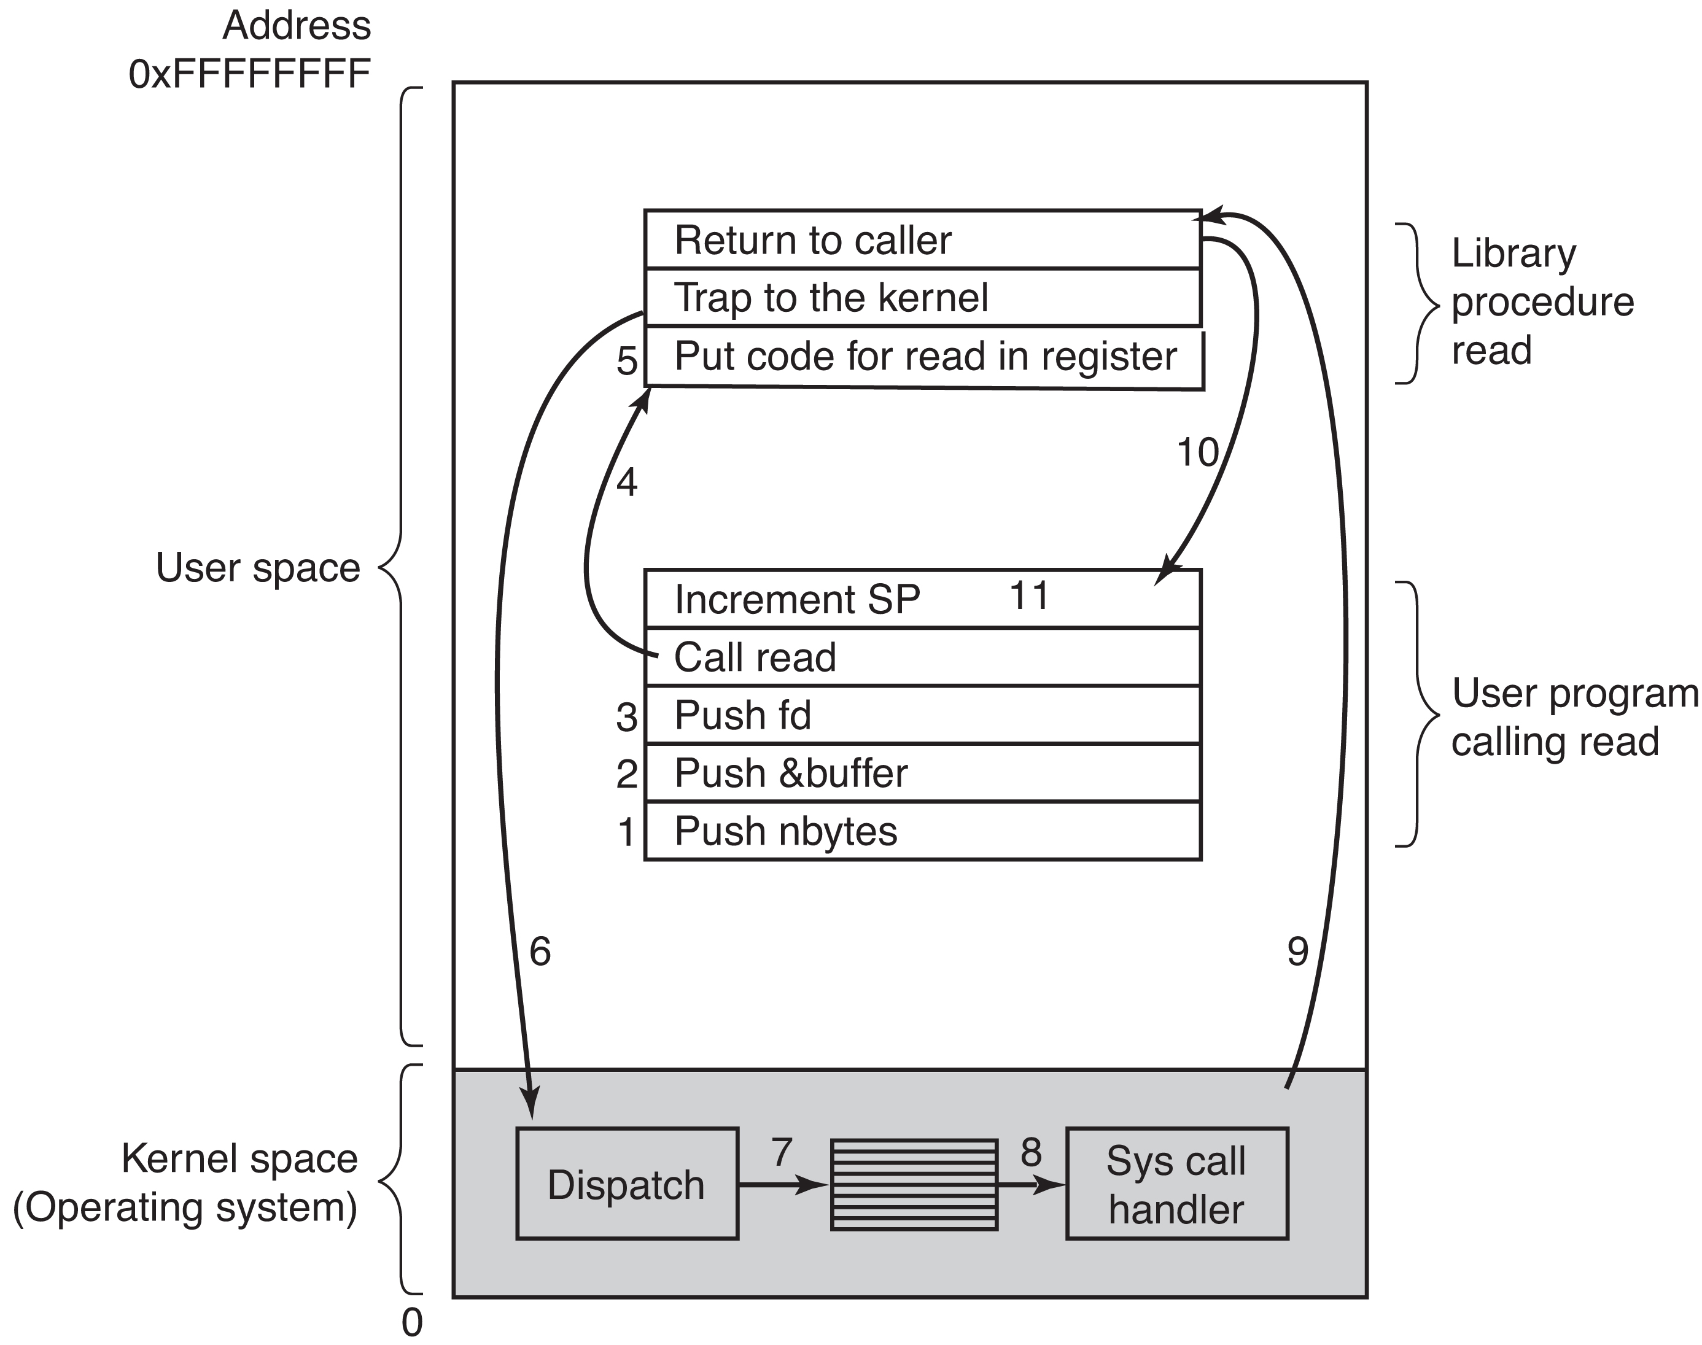
System Call
count = read(fd, buffer, nbytes);
system call #
(pop)
From Modern Operating Systems, 4th edition, by Tanenbaum and Bos
[U➔K]

Slide 10
System Calls
Allow kernel to carefully expose certain key pieces of functionalities (access files, create process, IPC, etc.) to user programs
trap instruction
jump into kernel and raise privilege level to kernel mode
push PC/SP onto per-process kernel stack
return-from-trap instruction
pop PC/SP off stack
return to calling program and reduce privilege level to user mode
Setup trap table (interrupt vector) at boot time
tell hardware what code to run when exceptional events occur, e.g., hard-disk or keyboard interrupt, or system call

Slide 11
Limited Direct Execution
time
process creation

Slide 12
#2 Switching between Processes
When one process is running on CPU, OS is not running ➔if OS is not running, how can it do anything at all?
How can OS regain control of CPU so it can switch from one process to another?
cooperative approach - process gives up CPU periodically when making system calls (e.g., yield) or does something illegal (illegal memory access) – what about infinite loop?
non-cooperative approach: OS takes control – need hardware support – timer interrupt – when interrupt raised, interrupt handler in OS runs, and OS regain control

Slide 13
Timer Interrupt
At boot time,
OS inform hardware of which code to run when (timer) interrupts occur
OS starts the timer
When interrupt occurs, hardware save the context (machine state) of the currently running process such that a subsequent return-from-trap instruction could resume its execution

Slide 14
Saving and Restoring Context
OS regains control of CPU cooperatively via system call or forcefully via timer interrupt
Scheduler decides which process to run next
Context switching
save context – execute assembly code to save PC, general registers, kernel stack pointer of “currently-running” process onto its kernel stack
restore context – restore registers, PC, and switch to the kernel stack for the soon-to-be-running process

Slide 15
Switching Stack
Kernel enters “switch code” in the context of the interrupted process and returns in the context of the soon-to-be-executing process
Two types of register saves/restores
when timer interrupt occurs, user registers of running process are implicitly saved by hardware into kernel stack of that process
when OS decides to switch from A to B, kernel registers are explicitly saved by software (i.e., the OS) into memory in the process structure of the process
moves the system from running as if it just trapped into the kernel from A to as if it just trapped into the kernel from B

Slide 16
Limited Direct Execution with Timer Interrupt
time
Two types of register save and restore
when timer interrupt occurs – user registers of running process are implicitly saved by hardware into kernel stack of the process
when OS decides to switch process – kernel registers are explicitly saved by OS software into PCB of process

Slide 17
Concurrency
What happens when timer interrupt occurs during system call?
What happens when interrupt occurs during the handling of an earlier interrupt?
Two possible solutions
disabling interrupts during interrupt processing
locking to protect concurrent access to internal kernel data structures

Slide 18
Why System Calls Look Like Procedure Calls?
You may wonder why a call to a system call, such as open() or read(), looks exactly like a typical procedure call in C; that is, if it looks just like a procedure call, how does the system know it’s a system call, and do all the right stuff? The simple reason: it is a procedure call, but hidden in- side that procedure call is the famous trap instruction. More specifically, when you call open() (for example), you are executing a procedure call into the C library. Therein, whether for open() or any of the other system calls provided, the library uses an agreed-upon calling convention with the kernel to put the arguments to open in well-known locations (e.g., on the stack, or in specific registers), puts the system-call number into a well-known location as well (again, onto the stack or a register), and then executes the aforementioned trap instruction. The code in the library after the trap unpacks return values and returns control to the program that issued the system call. Thus, the parts of the C library that make system calls are hand-coded in assembly, as they need to carefully follow convention in order to process arguments and return values correctly, as well as execute the hardware-specific trap instruction. And now you know why you personally don’t have to write assembly code to trap into an OS; somebody has already written that assembly for you.

